Slide 1
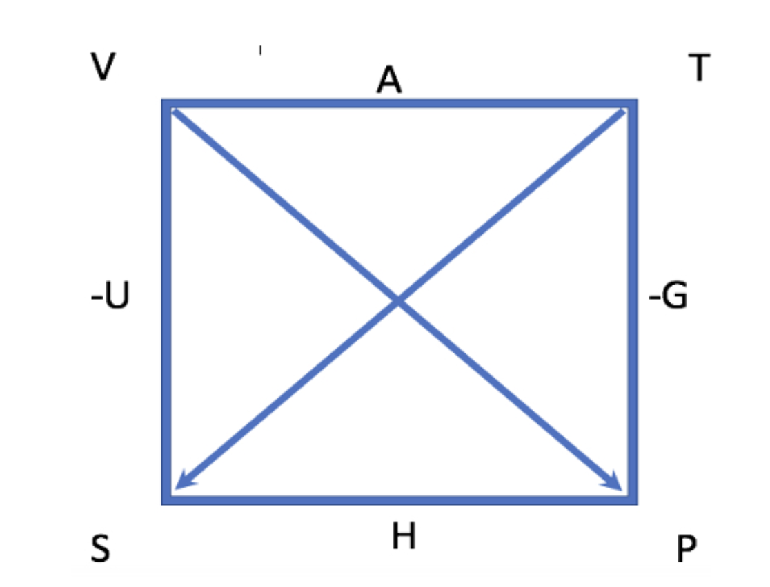


How AnalyticalMuT used The Box to generate the expressions for $π_{T}$ and $μ_{T}$ (derivation)
?

Slide 2
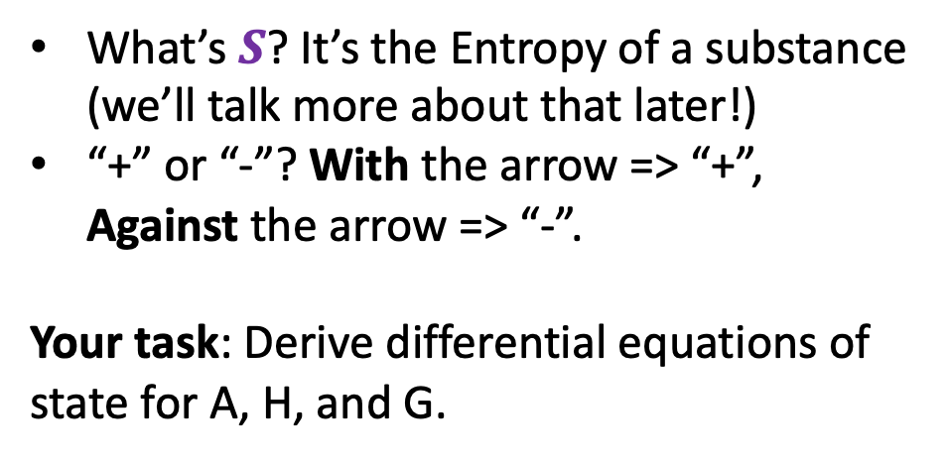
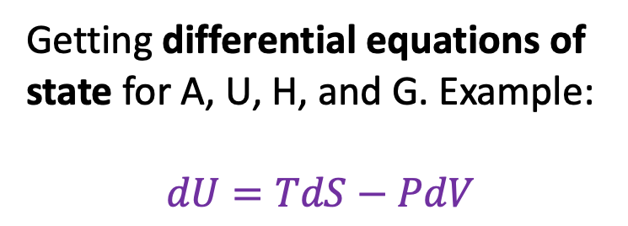
How AnalyticalMuT used The Box to generate the expressions for $π_{T}$ and $μ_{T}$ (derivation)
What’s $S$? It’s the Entropy of a substance (we’ll talk more about that later!)
“+” or “-”? With the arrow => “+”, Against the arrow => “-”.
Your task: Derive differential equations of state for A, H, and G.
Getting differential equations of state for A, U, H, and G. Example:
$$dU=TdS−PdV$$

Slide 3
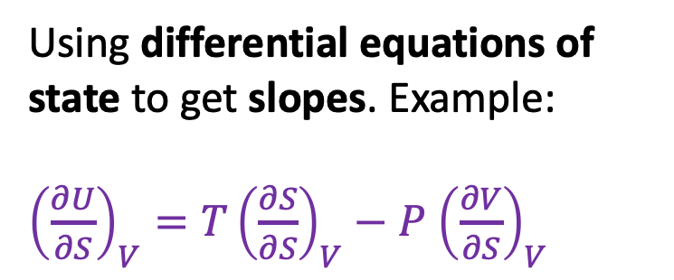
How AnalyticalMuT used The Box to generate the expressions for $π_{T}$ and $μ_{T}$ (derivation)
Using differential equations of state to get slopes. Example:
${\left(\frac{∂U}{∂S}\right)}_{V}=T{\left(\frac{∂S}{∂S}\right)}_{V}−P$ ${\left(\frac{∂V}{∂S}\right)}_{V}$
Some of these terms can be identified as no-brainers.

Slide 4
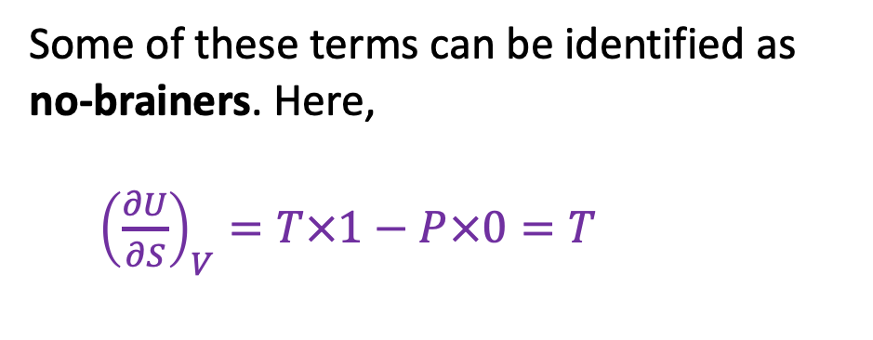
How AnalyticalMuT used The Box to generate the expressions for $π_{T}$ and $μ_{T}$ (derivation)
Using differential equations of state to get slopes. Example:
${\left(\frac{∂U}{∂S}\right)}_{V}=T{\left(\frac{∂S}{∂S}\right)}_{V}−P$ ${\left(\frac{∂V}{∂S}\right)}_{V}$
Some of these terms can be identified as no-brainers. Here,
${\left(\frac{∂U}{∂S}\right)}_{V}=T×1−P×0=T$

Slide 5
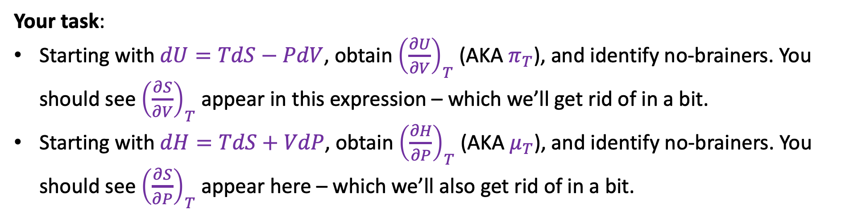
How AnalyticalMuT used The Box to generate the expressions for $π_{T}$ and $μ_{T}$ (derivation)
Your task:
Starting with $dU=TdS−PdV$, obtain ${\left(\frac{∂U}{∂V}\right)}_{T}$ (AKA $π_{T}$), and identify no-brainers. You should see ${\left(\frac{∂S}{∂V}\right)}_{T}$ appear in this expression – which we’ll get rid of in a bit.
Starting with $dH=TdS+VdP$, obtain ${\left(\frac{∂H}{∂P}\right)}_{T}$ (AKA $μ_{T}$), and identify no-brainers. You should see ${\left(\frac{∂S}{∂P}\right)}_{T}$ appear here – which we’ll also get rid of in a bit.

Slide 6
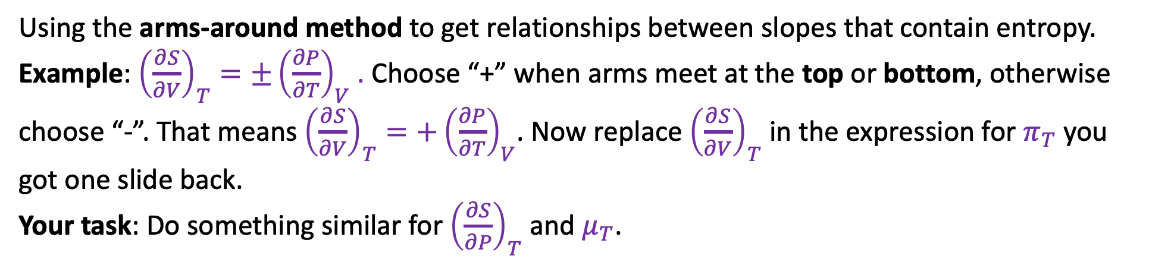
How AnalyticalMuT used The Box to generate the expressions for $π_{T}$ and $μ_{T}$ (derivation)
Using the arms-around method to get relationships between slopes that contain entropy. Example: ${\left(\frac{∂S}{∂V}\right)}_{T}={±\left(\frac{∂P}{∂T}\right)}_{V}$ . Choose “+” when arms meet at the top or bottom, otherwise choose “-”. That means ${\left(\frac{∂S}{∂V}\right)}_{T}={+\left(\frac{∂P}{∂T}\right)}_{V}$. Now replace ${\left(\frac{∂S}{∂V}\right)}_{T}$ in the expression for $π_{T}$ you got one slide back.
Your task: Do something similar for ${\left(\frac{∂S}{∂P}\right)}_{T}$ and $μ_{T}$.

Slide 7
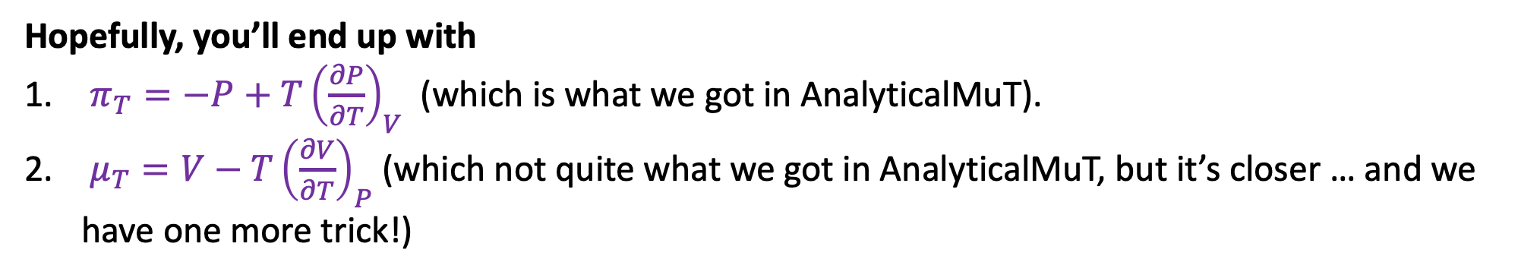
How AnalyticalMuT used The Box to generate the expressions for $π_{T}$ and $μ_{T}$ (derivation)
Hopefully, you’ll end up with
$π_{T}={−P+T\left(\frac{∂P}{∂T}\right)}_{V}$ (which is what we got in AnalyticalMuT).
$μ_{T}={V−T\left(\frac{∂V}{∂T}\right)}_{P}$ (which not quite what we got in AnalyticalMuT, but it’s closer … and we have one more trick!)

